Slide 1


Data Governance with
Databricks Unity Catalog
Tips, Tricks and Best Practices
Vuong Nguyen Lead Solutions Architect @ Databricks
Liping Huang Sr. Solutions Architect @ Databricks

Slide 2

Data and AI governance is complex
Data consumers
Data governance team
“Where is the data, models, notebooks, dashboards that I need?”
Permissions on files
Data lake
Data analyst
“How to secure these assets?”
Permissions on tables, rows and columns
Data warehouse
Data engineer
“Who is accessing them and how?”
Permissions on ML models, features
AI platform
Data scientist
“Are we compliant?”
Permissions on reports, dashboards
BI dashboards
ML Practitioners
Notes:
so I wanted to begin with a short motivation behind Unity catalog we announced it at this conference two years ago and we did so because we saw this fundamental challenge with the ways the organizations were managing their data governance practices and the challenge went swimming like this we saw all of these different data consumers: analysts Engineers scientists ml practitioners trying to access data from all of these different systems and the governance team was struggling to keep up
so if we take one element of governance which is access control on file a data Lake they might be configuring permissions on files using Cloud Primitives, on data warehouses they might be issuing SQL grants and on AI
platforms they'd be doing something completely different

Slide 3
Databricks unifies governance for data and AI
Data consumers
Data governance team
“Simple unified solution to manage data and AI governance.”
“Easy to discover what I need!!”
Data lake
“Abstracts the complexity of the underlying architecture.”
Data analyst
Databricks Unity Catalog
Data warehouse
Data engineer
One security and governance model for structured/unstructured data as well as AI
AI platform
Data scientist
BI dashboards
ML Practitioners
Notes:
so we saw this opportunity to provide a unified governance framework which makes all of these different data consumers incredibly productive while keeping the data governance team sane and most importantly in compliance

Slide 4




Key elements of governance
Secure and auditable
Discoverable
Usable and performant
Accurate and high quality
Notes:
so I spent my last two years just speaking to hundreds of customers about how specifically Unity catalog could help with their governance practices and these four elements typically clicked with all customers
so the first was that we they all expressed they want their data to be secure and auditable so we want to be able to assert a rule that says who can access which piece of data and then to be able to answer fundamental questions such as who did access who can access and what did they do
secondly we want to make our data discoverable and give users the tools to discover that data
thirdly we want to make sure that our data is usable and performant right there's no point having broken tables out there that will just error when you try and query them it's just taking up a necessary storage space
and then the final one we want to make sure that our data is accurate and high quality because essentially people are making decisions off this data

Slide 5
How do we get there?
Centralized access control for data & AI
Built-in data search and discovery
Performance & scalability
Lineage & data quality
Notes:
so what I wanted to do in this talk is go through each of these four chapters and talk about the new features in unity catalog that help you address these and some sneak peeks at some uh currently unreleased stuff as well

Slide 6
How do we get there?
Centralized access control for data & AI
Built-in data search and discovery
Performance & scalability
Lineage & data quality
Notes:
so what I wanted to do in this talk is go through each of these four chapters and talk about the new features in unity catalog that help you address these and some sneak peeks at some uh currently unreleased stuff as well

Slide 7


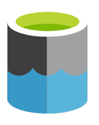



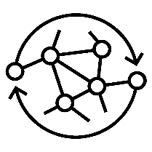







Access control for data + AI assets
VOLUMES = Access control for non-tabular data
Cloud storage
TABLES = Access control for tabular data
+ COLUMN & ROW security
Notebooks/ queries
Feature store
Feature store
Other system
Bronze
Silver
Gold
Models
…
LAKEHOUSE FEDERATION = Governance beyond the lakehouse!
Dashboards
MODELS = Access control for AI
Notes:
and if you've spoken to databricks over the last five years or so you'll have seen some variant of this diagram right it's the data ingestion life cycle we take data from cloud storage it goes through these levels of refinement bronze silver gold and then it's served out to end consumers
so if we're thinking about securing this from an access control perspective we might want to start with tabular data, and in unity catalog we give you this really simple way to say Vuong is allowed to see all of the tables in this particular schema but maybe your compliance team then comes back and says well Vuong isn't that highly privileged Vuong shouldn't be able to see the columns which have sensitive data in them so that's where our column and row level security comes in. You can assert that Vuong can see all the data in the schema but not anything that has sensitive data in it.
Then we allow you to apply these tabular access controls to anywhere in databricks where you have tabular data, so for example in the machine learning world we have something called a feature
store and you can use exactly the same methodology to secure the feature tables.
we talked about tabular data, let's talk about non-tabular data and a really good framing use case for this is machine learning so let's say we have some image files in S3 we want to use a model on those images. how do we do that in unity catalog? well volumes gives us a way to take a portion of our cloud storage system like a prefix in S3, you register that as a volume in unity catalog and then you can give access to that volume to individual users or groups just like you would do with tables
if we take that use case forward I want to use a model or train a model well I need somewhere to store that as well and we're now really excited because you can put models in unity catalog as well
and this ensures that they're tamper proof no one can mess with them as well as you can actually control who can execute those models as well
there's one other thing missing from this diagram and for those large organizations you might be wondering well it'd be great if all my data was in cloud storage I have a hundred back-end application databases which haven't yet been etl'd into the lake how do I get access to those and this is where Lakehouse Federation comes in. This is in public preview and it essentially allows you to register these other systems like postgres,snowflake, MySQL in unity catalog and then use all of these Access Control Primitives on top of them
so to highlight this I wanted to actually give a demo of what this looks like

Slide 8
Demo: Access Control for the Lakehouse

Slide 9




Clusters
Shared Cluster
Single User Cluster
Support concurrent users/workloads with full isolation guarantees, fine grained security
Support advanced use cases such as GPUs, distributed ML, RDDs
Notes:
Switch tracks slightly here, for those of you who have used Unity Catalog you'll know that there's these two different types of clusters that we support.
One is a shared cluster this is good for 90% of your use cases where we support all the fine grain Access Control
And then we have these single user clusters which the model here is if you want to do some at slightly more advanced like you want to use a GPU or you want to do distributed machine learning and you break yourself out onto this cluster and safely isolate yourself

Slide 10


UC Shared clusters
Develop and deploy your workloads on shared clusters!
Improved functionalities
Python cluster libraries
Scalar Python/Pandas UDFs
Single node ML & MLflow
Structured Streaming
Network connectivity from Python
Scala
Init scripts / Jars
Interactive development
Scheduled workflows
Shared Cluster
Support concurrent users/workloads with full isolation guarantees
Notes:
And our eventual vision for this is to unify the two types of clusters but on the journey there we're going to make improvements to both sides
So with UC share clusters you'll have seen a bunch of improvements recently: ability to install python cluster libraries, single node machine learning, streaming and then Scala and init scripts and jars and also really
soon we'll be allowing you to load a version of the machine learning runtime onto these clusters

Slide 11

Fine-grained access control for single-user clusters
Private Preview
Query views and masked tables securely from single-user clusters!
View and masked table access:
Data filtered via secure, serverless filtering service,
Filtered results are streamed back to the single user cluster
table_1
table_1
view_1
view_1
Single user
cluster
SELECT *
FROM view_1
Single user
cluster
Filtering Service
SELECT *
FROM view_1
table_2
No access
table_2
Notes:
but I mainly wanted to talk about single user clusters
so if you remember this is the type of cluster that you break out onto when you want to do some slightly more advanced
so let's say that you downloaded the latest distributed machine learning algorithm bleeding edge from the internet and you want to run it against your data so you isolate yourself on the single user cluster
the challenge right now is to allow this kind of workload to work we actually have to assume that the workload and the user has access to the full jvm and the full set of data on that cluster this makes it really hard to enforce fine grain security and simply what we do today is we fail the query securely so if you try and access data that's secured by fine-grained access control then we'll actually fail the query
What we're working on is actually a filtering service that will address this gap
how this will work is when you query from a view or a table secured by fine-grained access controls the data will be pre-filtered through this serverless filtering service ensuring that only the records that you're allowed to see make it onto that cluster meaning that you can both run arbitrarily complex workloads while getting the same level of access on your shared clusters and single user clusters so we're really excited about this and there'll be definitely more announcements about this in the future

Slide 12
How do we get there?
Centralized access control for data & AI
Built-in data search and discovery
Performance & scalability
Lineage & data quality
Notes:
so what I wanted to do in this talk is go through each of these four chapters and talk about the new features in unity catalog that help you address these and some sneak peeks at some uh currently unreleased stuff as well

Slide 13
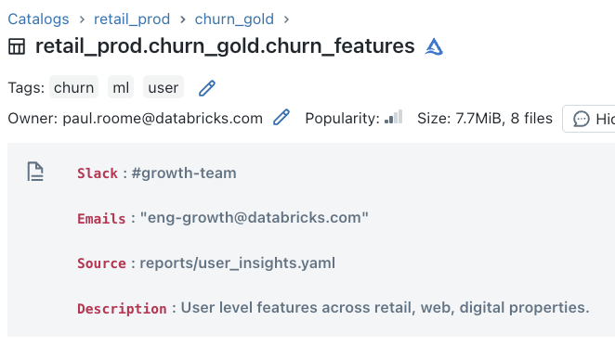
Describe and tag data
Public Preview
Notes:
https://data-ai-indus.cloud.databricks.com/explore/data/dbdemos/uc_lineage/ggw_dinner?o=1781809998795474

Slide 14
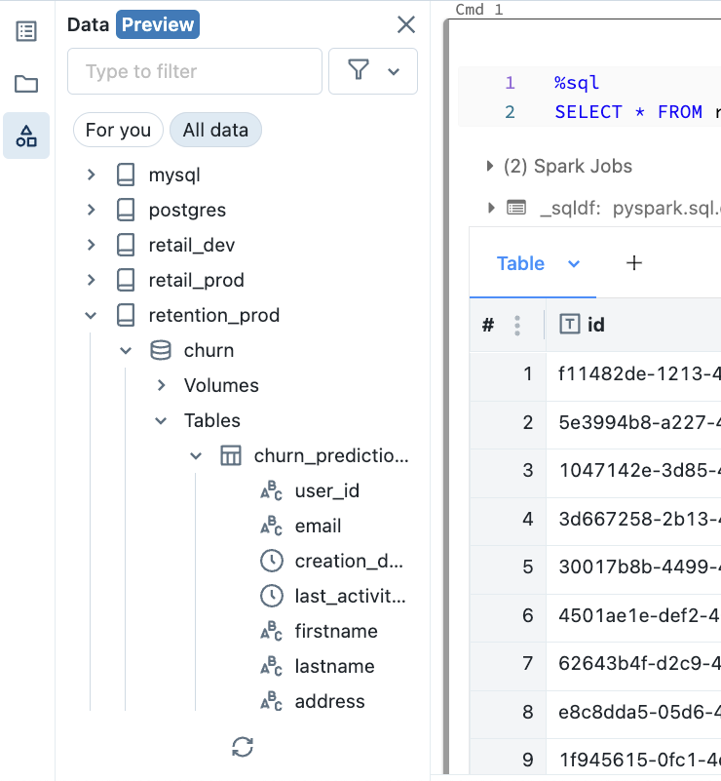
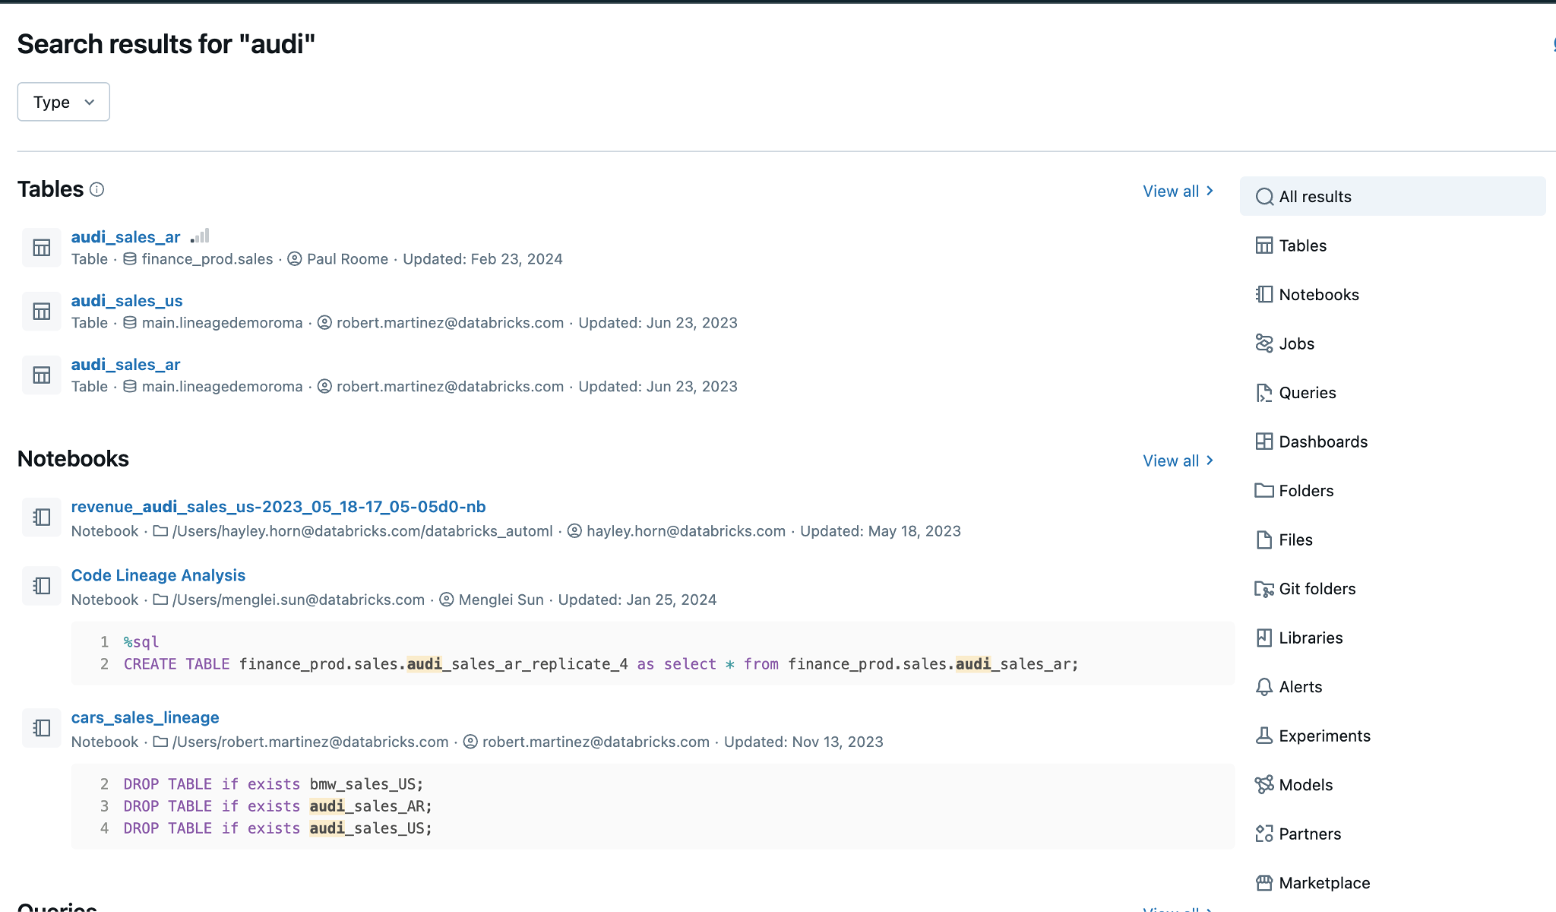
Find and discover assets
Search for any lakehouse entity!
Data browser in the notebook!

Slide 15
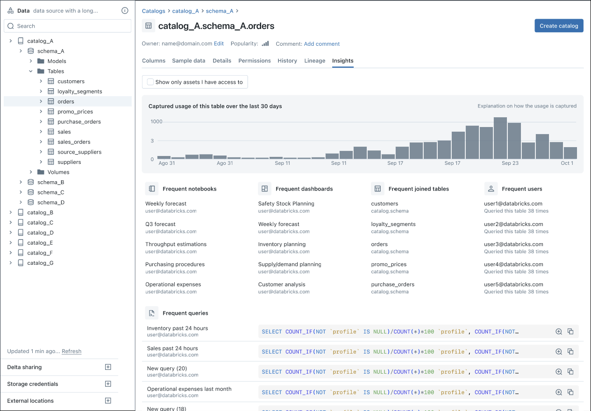
Data insights
Frequent notebooks/queries/dashboards: How do I get started?
Frequent Joins: How can I enrich?
Frequent users: Who are the experts?

Slide 16
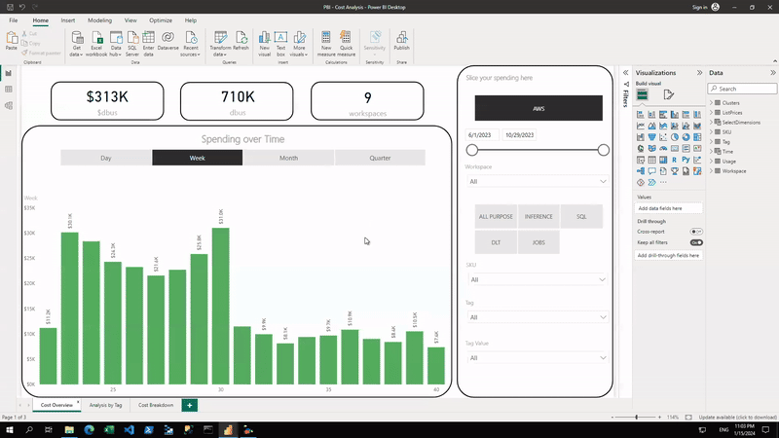
Governance for Data+AI with Data+AI
Powered by AI on Databricks System Tables with UC
Power BI Template for Cost Analysis and Cross Charge
https://bit.ly/3SVTniP
Notes:
~75% / ~60% accuracy on trend prediction for 7d /28d forecasts in Staging!

Slide 17
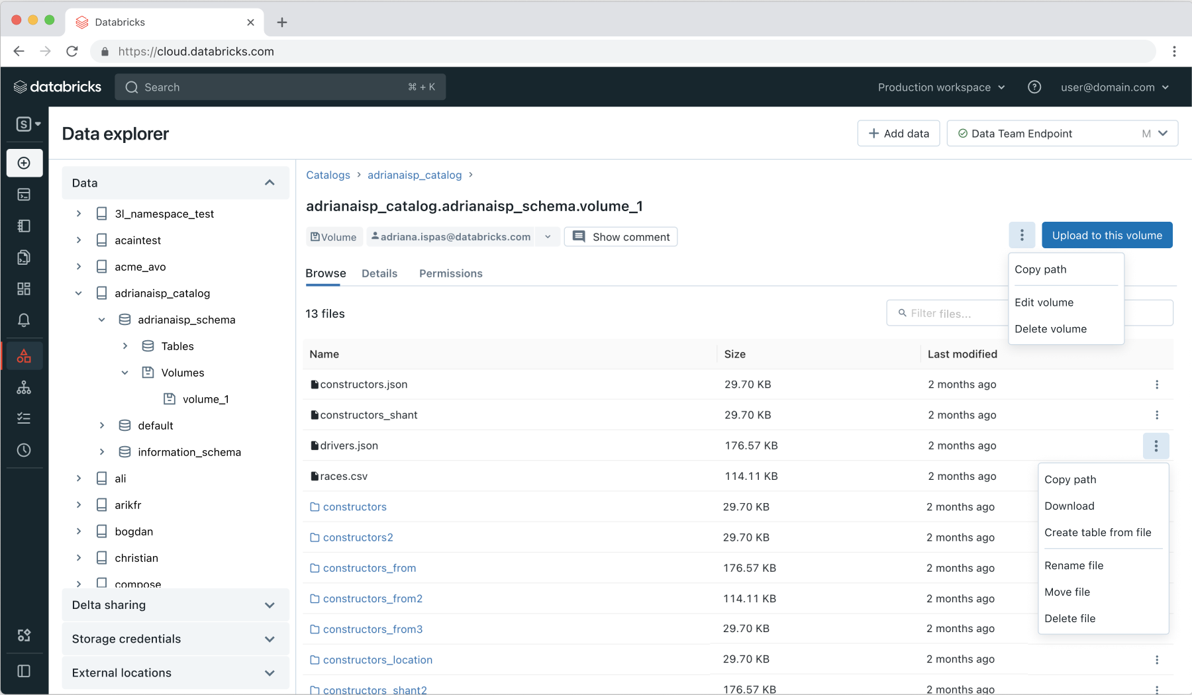
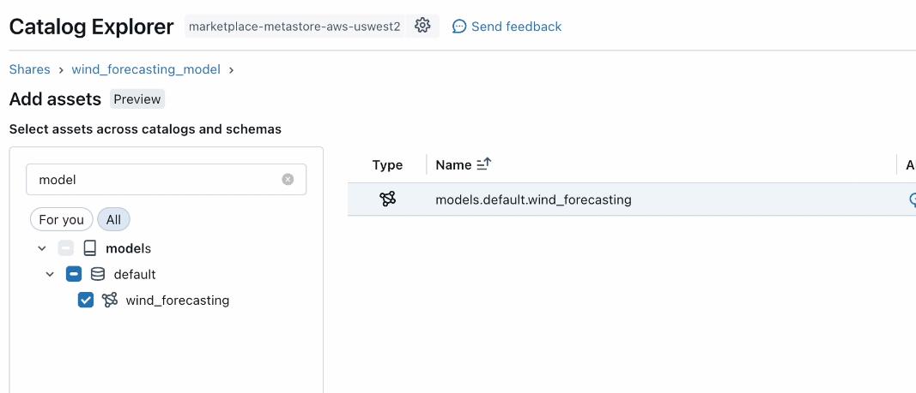
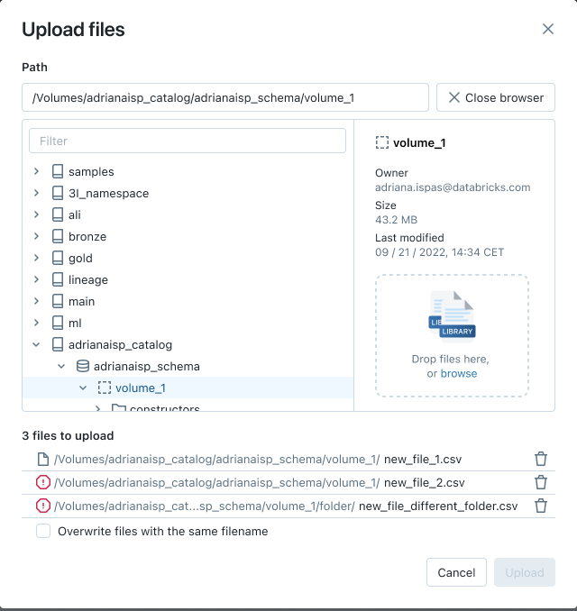
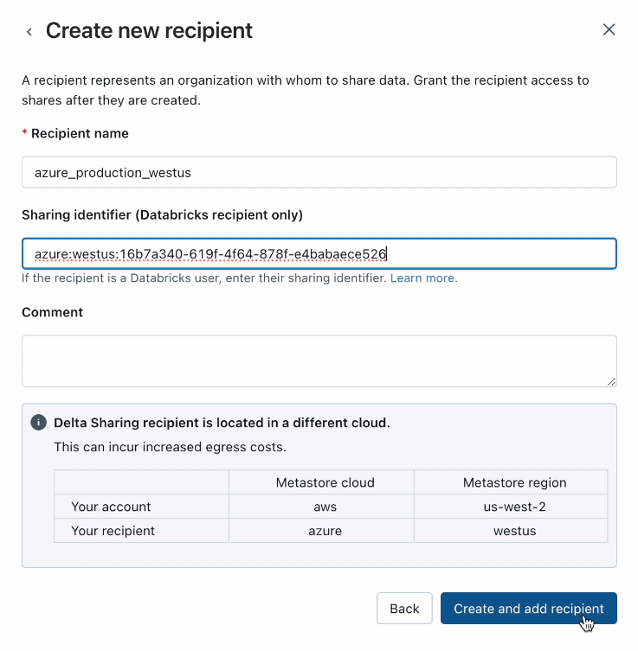
Sharing tabular & non-tabular data
Volumes & AI model sharing with Delta Sharing

Slide 18
How do we get there?
Centralized access control for data & AI
Built-in data search and discovery
Performance & scalability
Lineage & data quality
Notes:
so what I wanted to do in this talk is go through each of these four chapters and talk about the new features in unity catalog that help you address these and some sneak peeks at some uh currently unreleased stuff as well

Slide 19
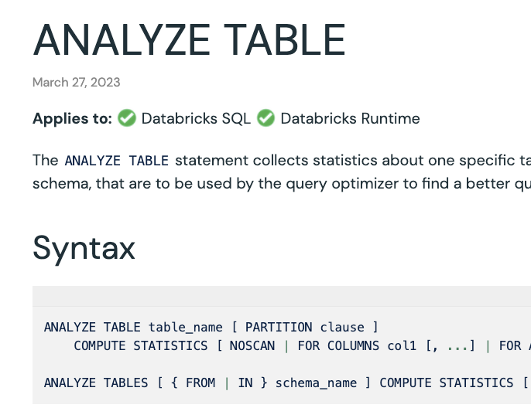
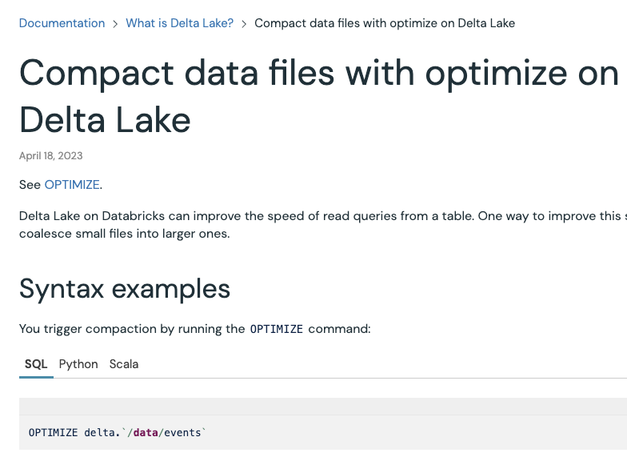
Predictive optimization
Challenge
Tables can can be optimized for faster price-performance, but…
Which tables?
How often?
What optimizations?
Notes:
Typically when I spoke to customers about this topic, the feedback I got was as a governance professional we just want a macro way to ensure that the price performance in our lakehouse is always optimal.
We've always had ways to basically increase the performance of tables by running optimize Z order or analyze table statistics but I don't want to leave it to the individual data engineer to do that, I want to apply a macro policy which just means that I don't need to think about it

Slide 20
Predictive Optimization
Public Preview
Solution
AI model determines which tables to optimize
Bin-packing
Liquid clustering
Vacuuming
Table statistics
Intelligent storage tiering
Databricks automatically performs maintenance
Using hyper-optimized serverless compute
Notes:
that's exactly what predictive optimization does. Essentially what happens here you turn it on for a catalog/schema and then it will determine which tables need to be optimized and go ahead and perform that optimization choosing the right one to actually perform so we think this is a big step forward

Slide 21
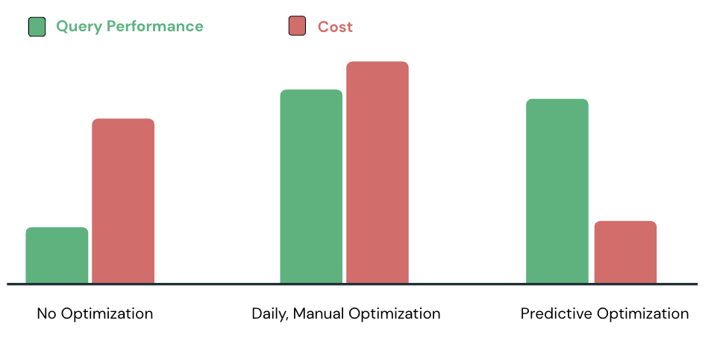
Predictive optimization
Public Preview
Results:
Fewer knobs
No need to:
Determine which tables to optimize
Run and manage the clusters

Slide 22






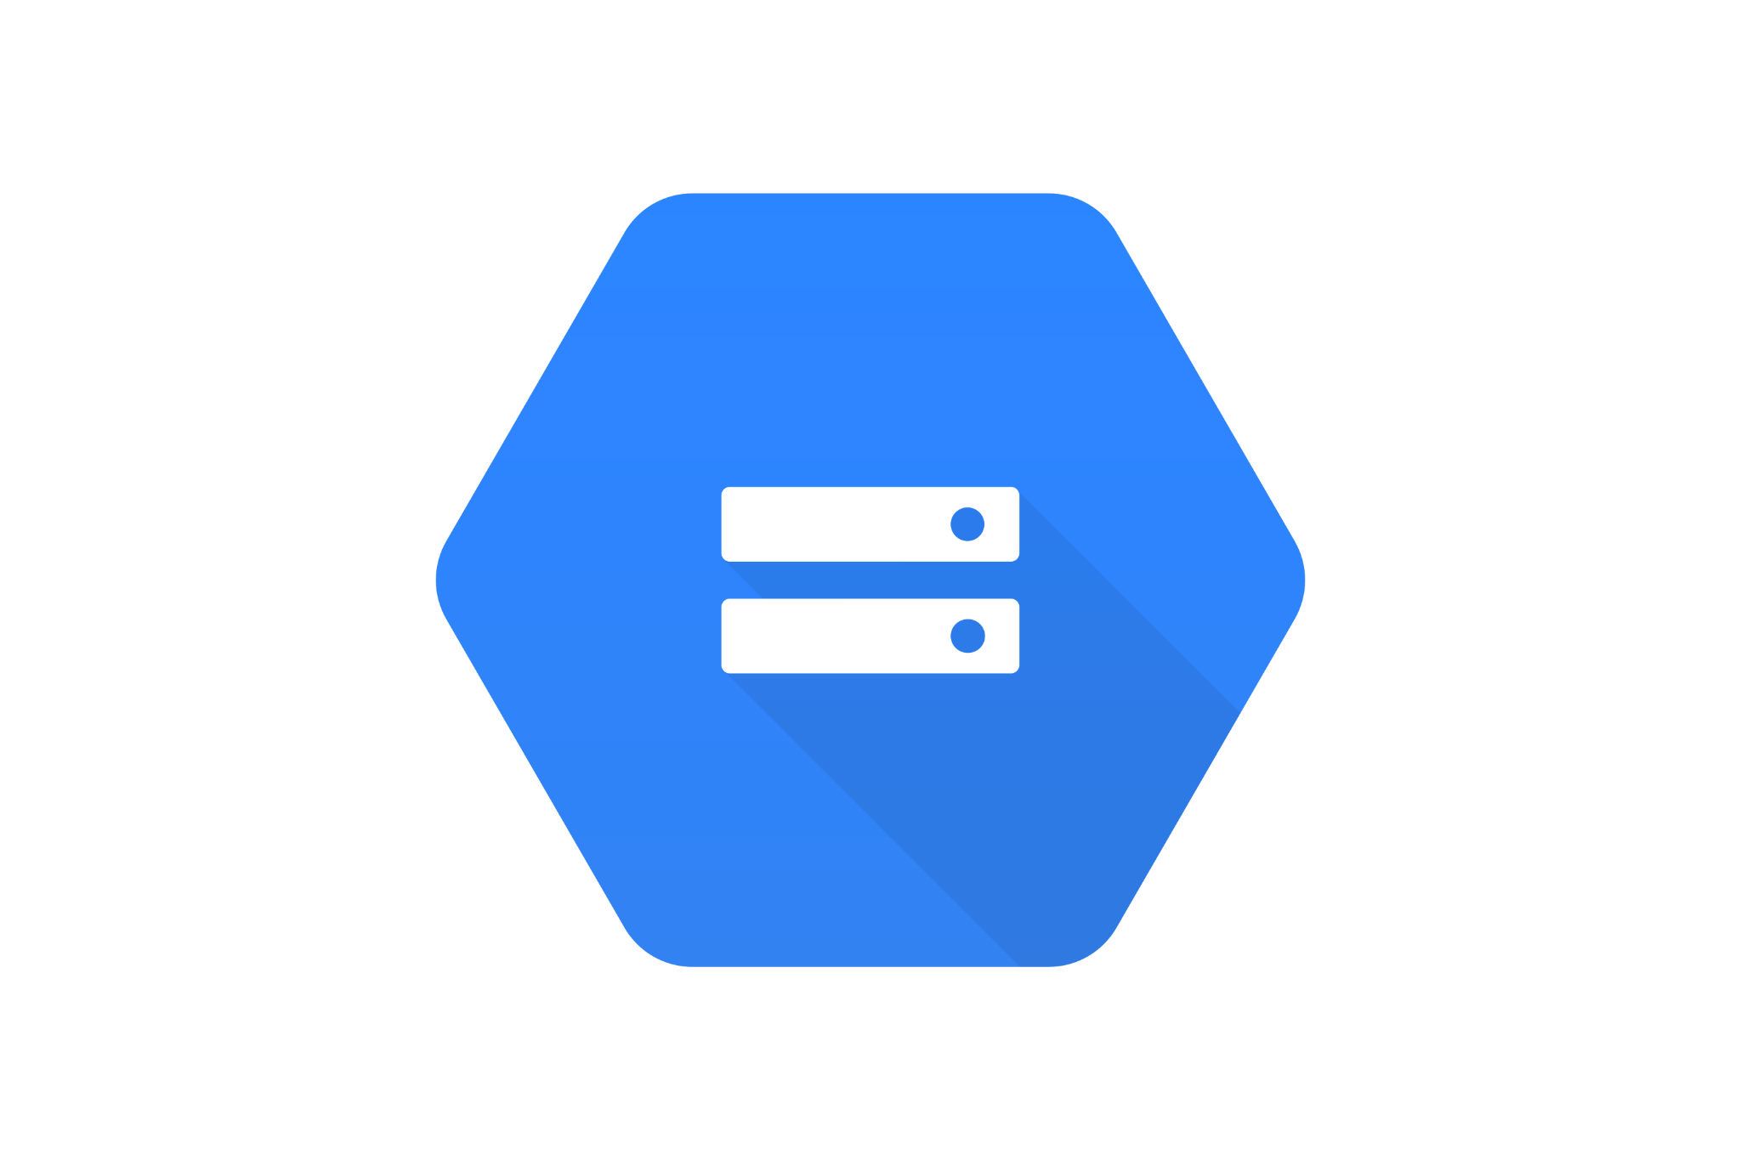



Streaming Tables & Materialized Views
Public Preview
CREATE STREAMING TABLE web_clicks
AS
SELECT *
FROM STREAM
read_files('s3://mybucket')
CREATE MATERIALIZED VIEW customer_orders
AS
SELECT
customers.name,
sum(orders.amount),
orders.orderdate
FROM orders
LEFT JOIN customers ON
orders.custkey = customers.c_custkey
GROUP BY
name,
orderdate;
CREATE STREAMING TABLE server_logs
AS
SELECT from_json(...) data
FROM STREAM
read_kafka(...)
Data stream
Results are pre-computed and incrementally refreshed
customers (Table)
orders (Table)
Cloud Storage
(S3, ADLS, GCS)
Message Queues
(Kafka, Pub/Sub, Kinesis, etc)

Slide 23
How do we get there?
Centralized access control for data & AI
Built-in data search and discovery
Performance & scalability
Lineage & data quality
Notes:
so what I wanted to do in this talk is go through each of these four chapters and talk about the new features in unity catalog that help you address these and some sneak peeks at some uh currently unreleased stuff as well

Slide 24
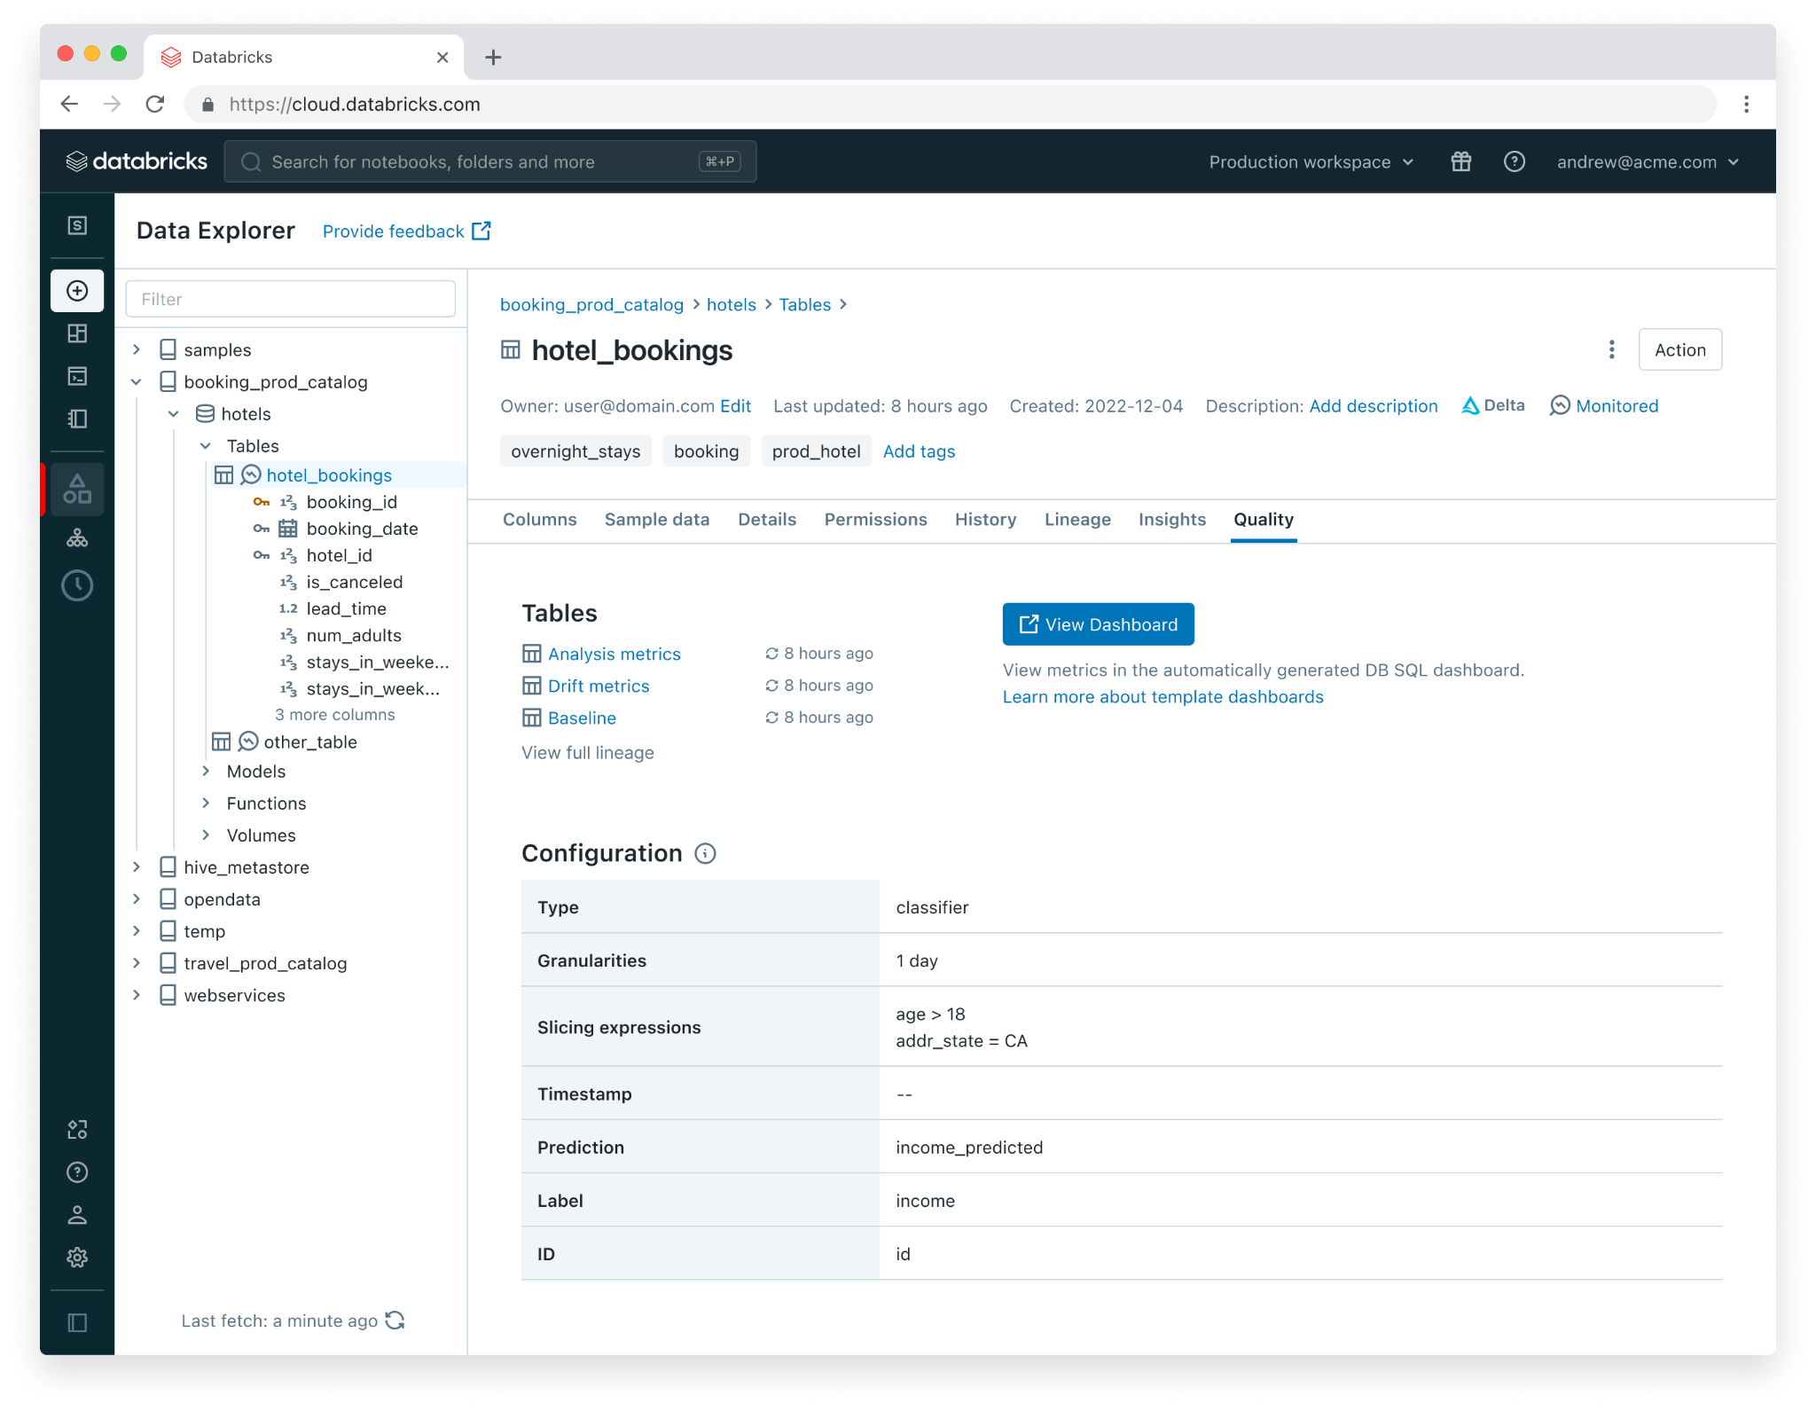
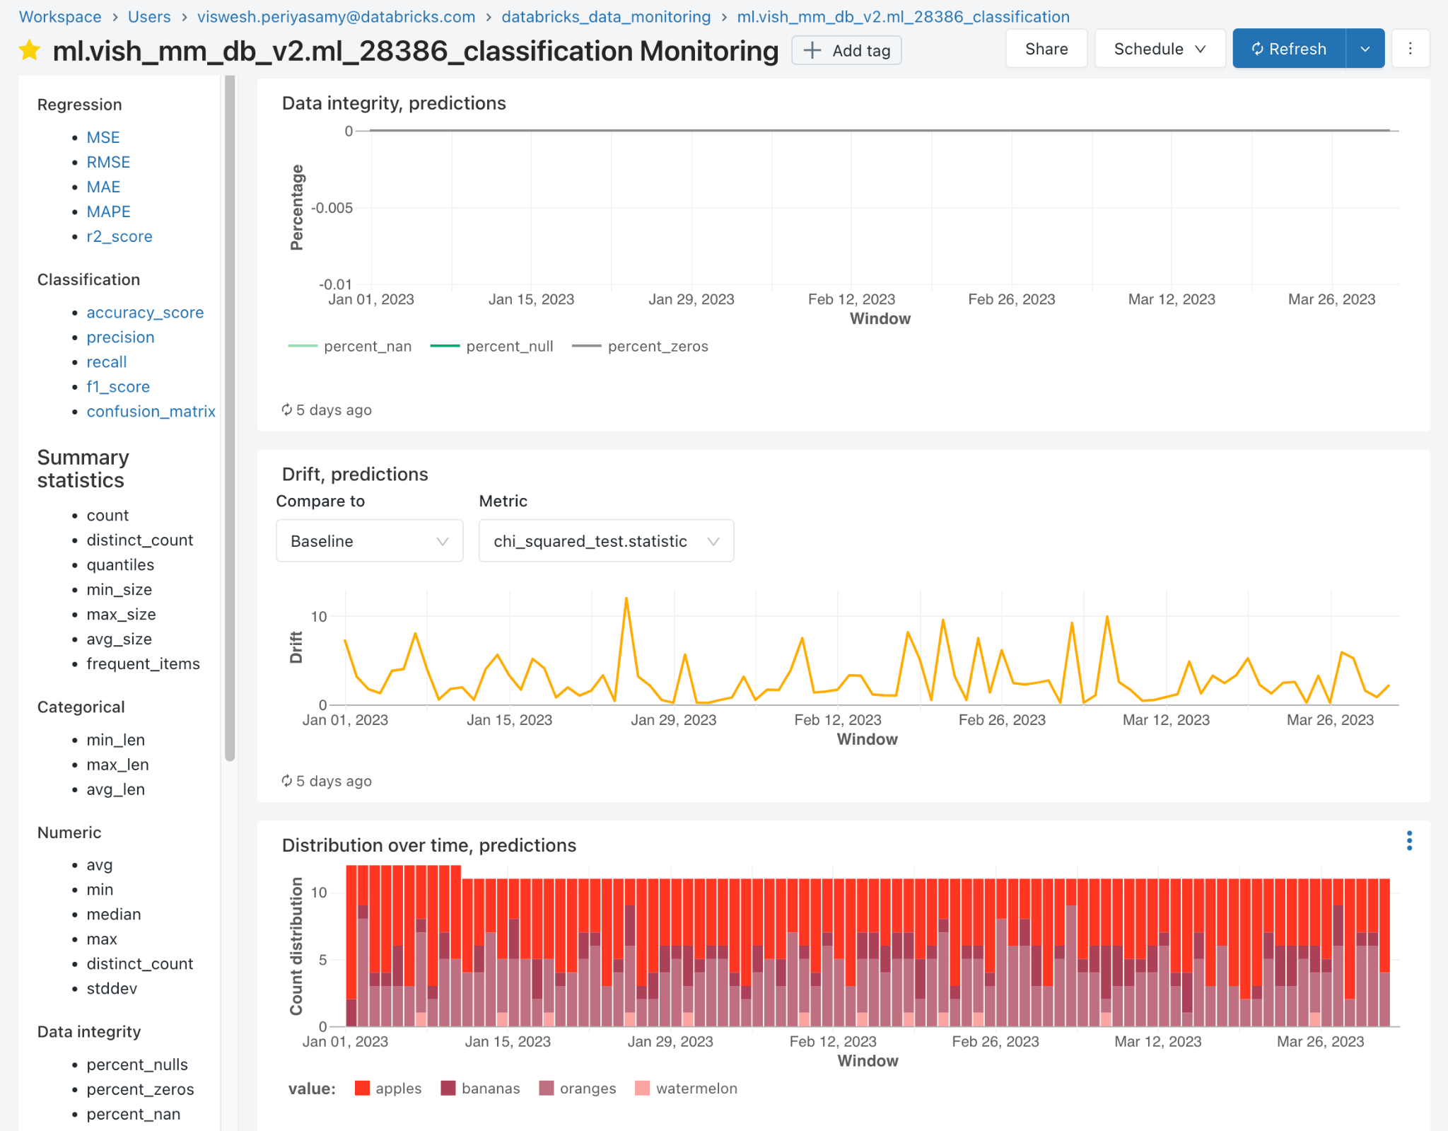
Lakehouse Monitoring
Public Preview
Background service that incrementally processes data in Unity Catalog tables
Calculates profile metrics stored in UC table
Calculates drift metrics stored in UC table
Supports custom metrics as SQL expressions
Auto-generates DBSQL dashboard to visualize metrics over time

Slide 25
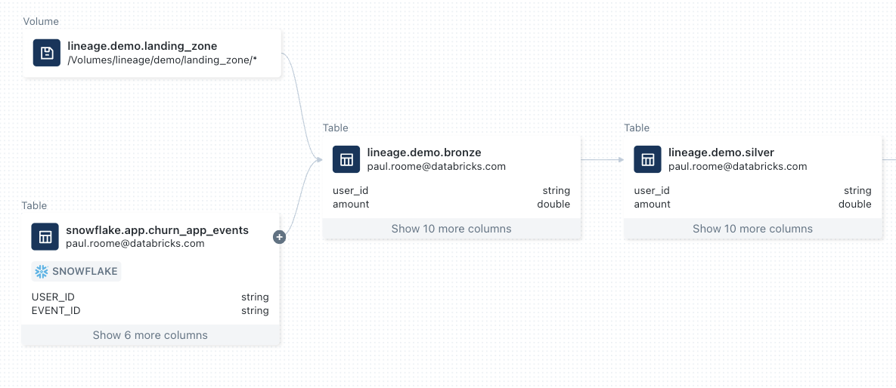
Lineage for the Lakehouse
Files
Automatic Data Documentation
Impact analysis
DLT
Feature store
Models
Democratized access (BROWSE)
Improved retention logic
Root cause analysis
Federated sources
Notes:
If you haven't tried it out yet in unity catalog we've implemented this system of automatically capturing and tracking data lineage and our vision here is to be able to describe all of the different relationships between entities in the lakehouse and we've made significant strides in this recently.
You'll see on the diagram here I have an example of this little blob in the in the top left hand corner. This is loading from files, from a volume in unity catalog.
Then secondly you'll see the snowflake icon, this is joining those files with a Federated source which is snowflake
And then we've added more compatibility for things like DLT, feature stores and others.
We've seen some really interesting customer use cases on this front.
The big three
automatic data documentation this is really useful for Discovery right if you're trying to understand what this table means have a look at what sources it pulls from
impact analysis if you're a data engineer and you've been told you've got to deprecate this column in your table who's going to scream at you tomorrow when everything goes wrong
root cause analysis so tracking down what went wrong when something does

Slide 26
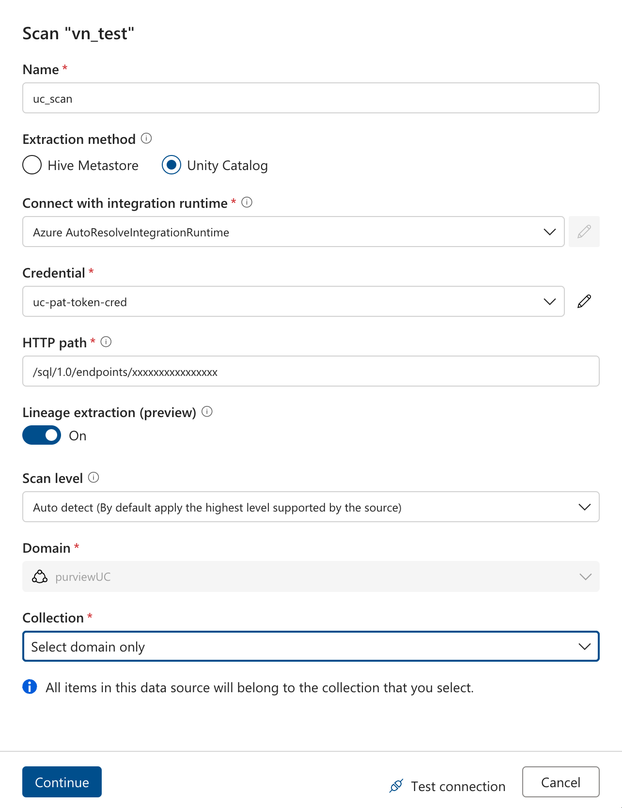
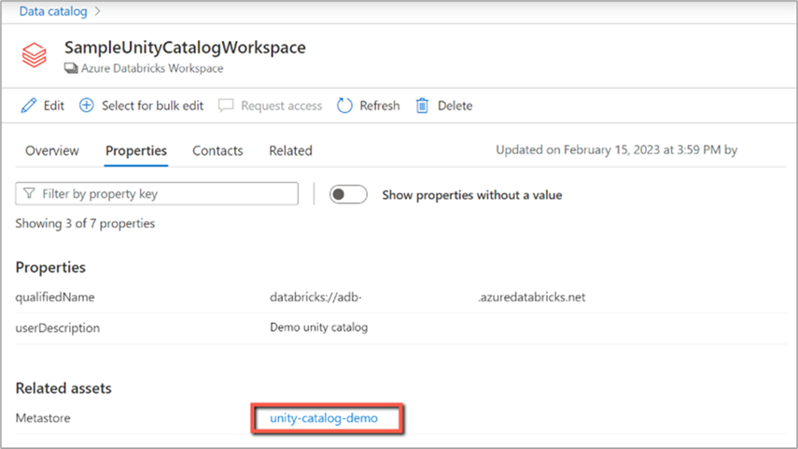
Microsoft Purview integration
Technical metadata - GA
Classification/Labelling - GA
Lineage - Preview
Policy Pushdown - Later in 2024

Slide 27
Demo: Lineage for the Lakehouse

Slide 28
Key elements of governance
Secure and auditable
Discoverable
Usable and performant
Accurate and high quality
Notes:
so I spent my last two years just speaking to hundreds of customers about how specifically Unity catalog could help with their governance practices and these four elements typically clicked with all customers
so the first was that we they all expressed they want their data to be secure and auditable so we want to be able to assert a rule that says who can access which piece of data and then to be able to answer fundamental questions such as who did access who can access and what did they do
secondly we want to make our data discoverable and give users the tools to discover that data
thirdly we want to make sure that our data is usable and performant right there's no point having broken tables out there that will just error when you try and query them it's just taking up a necessary storage space
and then the final one we want to make sure that our data is accurate and high quality because essentially people are making decisions off this data

Slide 29
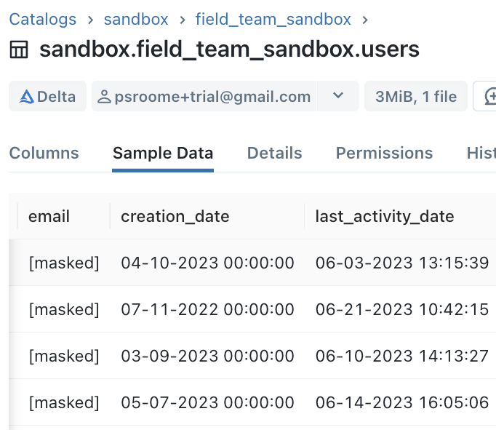
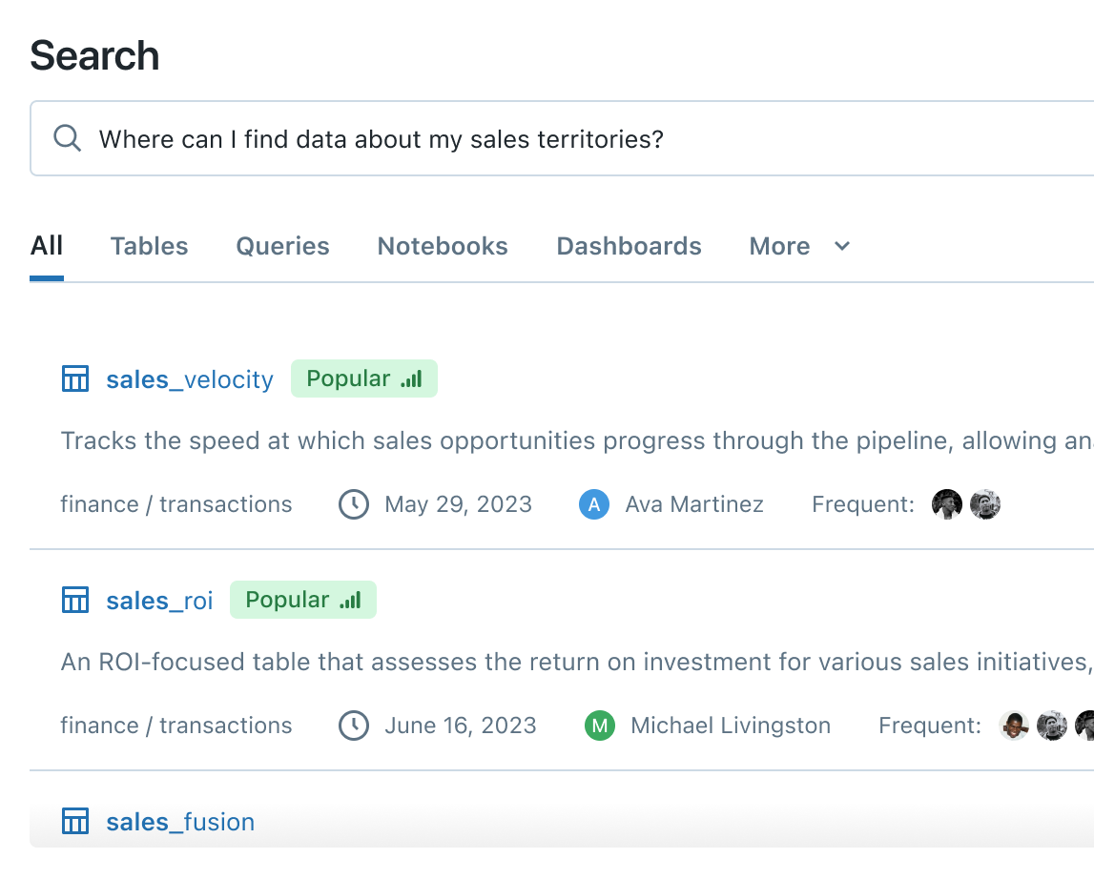
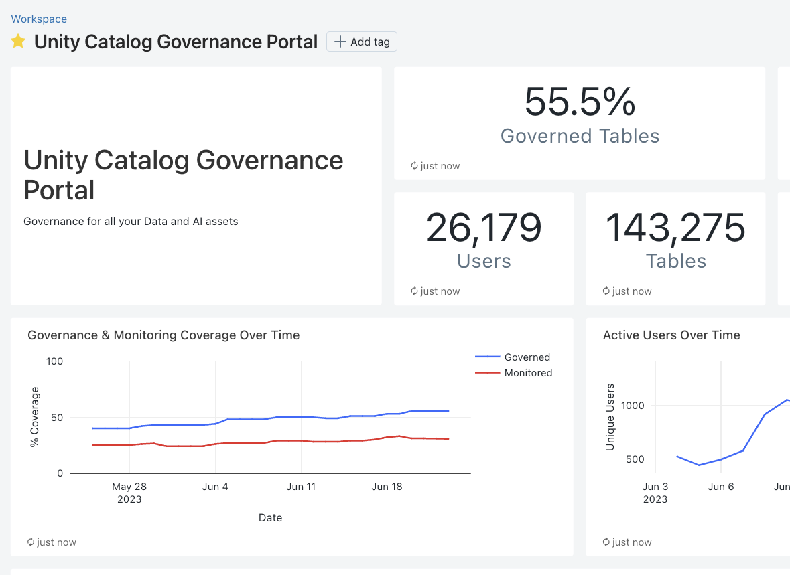
Even more on the horizon…
LakehouseIQ Augmented Search + Discovery
Auto Tag + Mask
Governance Portal
Notes:
but there's more. Next year is going to be very exciting for Unity catalog
some of this was announced at Summit like Lakehouse IQ are going to revolutionize How We Do search and Discovery in the platform as well as Lakehouse monitoring that's going to be helping us do the auto tag and mask and the improved observability through the governance portal

Slide 30
Thank You!

